Slide 1
THIẾT KẾ VÀ CÀI ĐẶT MẠNG
Ths. Nguyễn Huỳnh Huy Khoa: CNTT – ĐH Nha Trang
Email: huynh@ntu.edu.vn
SĐT: 077.2567899

Slide 2
Chapter One Analyzing Business Goals and Constraints

Slide 3
What is Network Design?
Network design should be a complete process that matches business needs to available technology to deliver a system that will maximize an organization’s success.
In the LAN area it is more than just buying a few devices.
In the WAN area it is more than just calling the phone company.

Slide 4
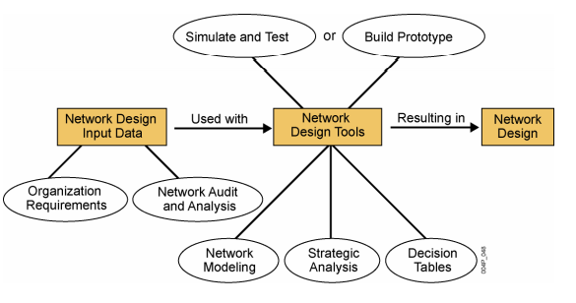
Step by step
Notes:
Layer 8 of the OSI model encompasses office politics, budgets, training, and other human factors.

Slide 5
Layers of the OSI Model Approach
Top-Down
Bottom - Up
Layer 7
Application
Layer 6
Presentation
Layer 5
Session
Layer 4
Transport
Layer 3
Network
Layer 2
Data Link
Layer 1
Physical
Notes:
Layer 8 of the OSI model encompasses office politics, budgets, training, and other human factors.

Slide 6
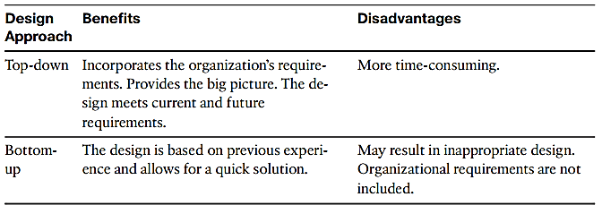
Layers of the OSI Model Approach
Top-Down
Bottom - Up
Notes:
Layer 8 of the OSI model encompasses office politics, budgets, training, and other human factors.

Slide 7
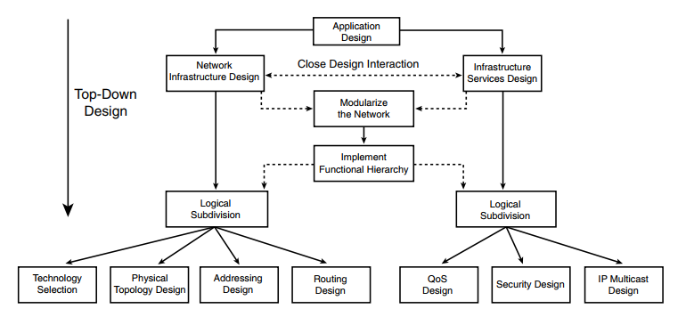
Layers of the OSI Model Approach
Top-Down
Notes:
Layer 8 of the OSI model encompasses office politics, budgets, training, and other human factors.

Slide 8
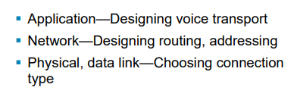
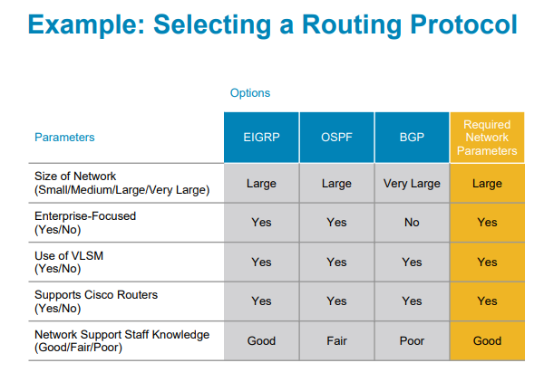
Layers of the OSI Model Approach
Top-Down
Notes:
Layer 8 of the OSI model encompasses office politics, budgets, training, and other human factors.

Slide 9
Start at the Top
Don’t just start connecting the dots.
Analyze business and technical goals first.
Explore divisional and group structures to find out who the network serves and where they reside.
Determine what applications will run on the network and how those applications behave on a network.
Focus on Layer 7 and above first.
Notes:
Layer 8 of the OSI model encompasses office politics, budgets, training, and other human factors.

Slide 10
Structured Design
A focus is placed on understanding data flow, data types, and processes that access or change the data.
A focus is placed on understanding the location and needs of user communities that access or change data and processes.
Several techniques and models can be used to characterize the existing system, new user requirements, and a structure for the future system.
A logical model is developed before the physical model.
The logical model represents the basic building blocks, divided by function, and the structure of the system.
The physical model represents devices and specific technologies and implementations.

Slide 11
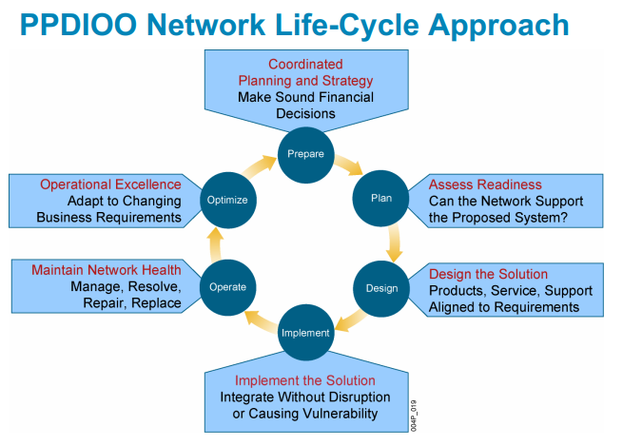
Systems Development Life Cycles
Typical systems are developed and continue to exist over a period of time, often called a systems development life cycle (SDLC).

Slide 12
Top-Down Network Design Steps
Analyze requirements
Monitor and optimize network performance
Develop logical design
Implement and test network
Develop physical design
Test, optimize, and document design

Slide 13
Network Design Steps
Phase 1 – Analyze Requirements
Analyze business goals and constraints
Analyze technical goals and tradeoffs
Characterize the existing network
Characterize network traffic

Slide 14
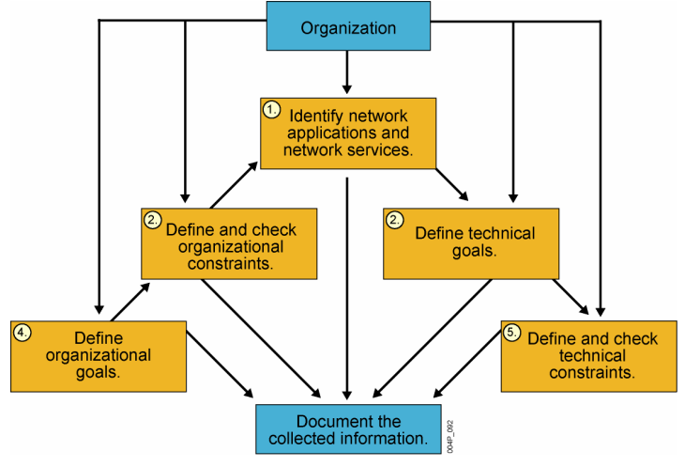
Network Design Steps
Phase 1 – Analyze Requirements

Slide 15
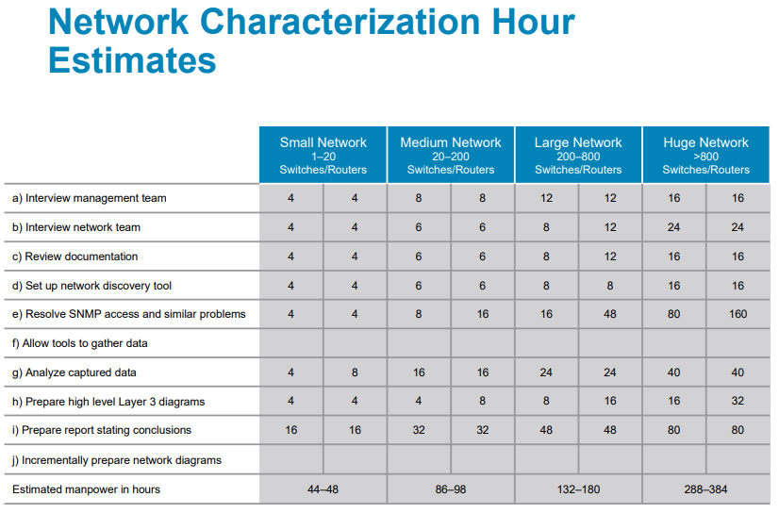
Network Design Steps
Phase 1 – Analyze Requirements

Slide 16
Network Design Steps
Phase 2 – Logical Network Design
Design a network topology
Design models for addressing and naming
Select switching and routing protocols
Develop network security strategies
Develop network management strategies

Slide 17
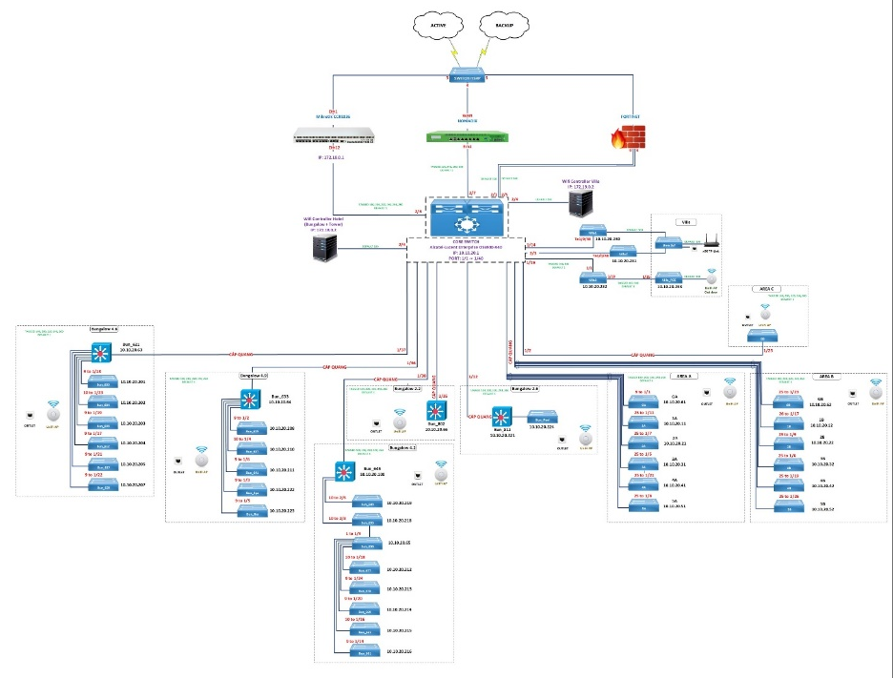
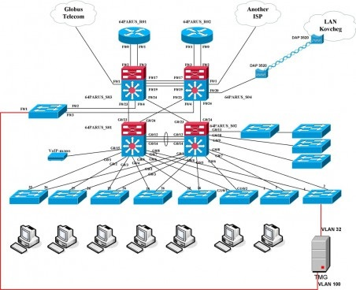
Network Design Steps
Phase 2 – Logical Network Design

Slide 18
Network Design Steps
Phase 3 – Physical Network Design
Select technologies and devices for campus networks
Select technologies and devices for enterprise networks

Slide 19
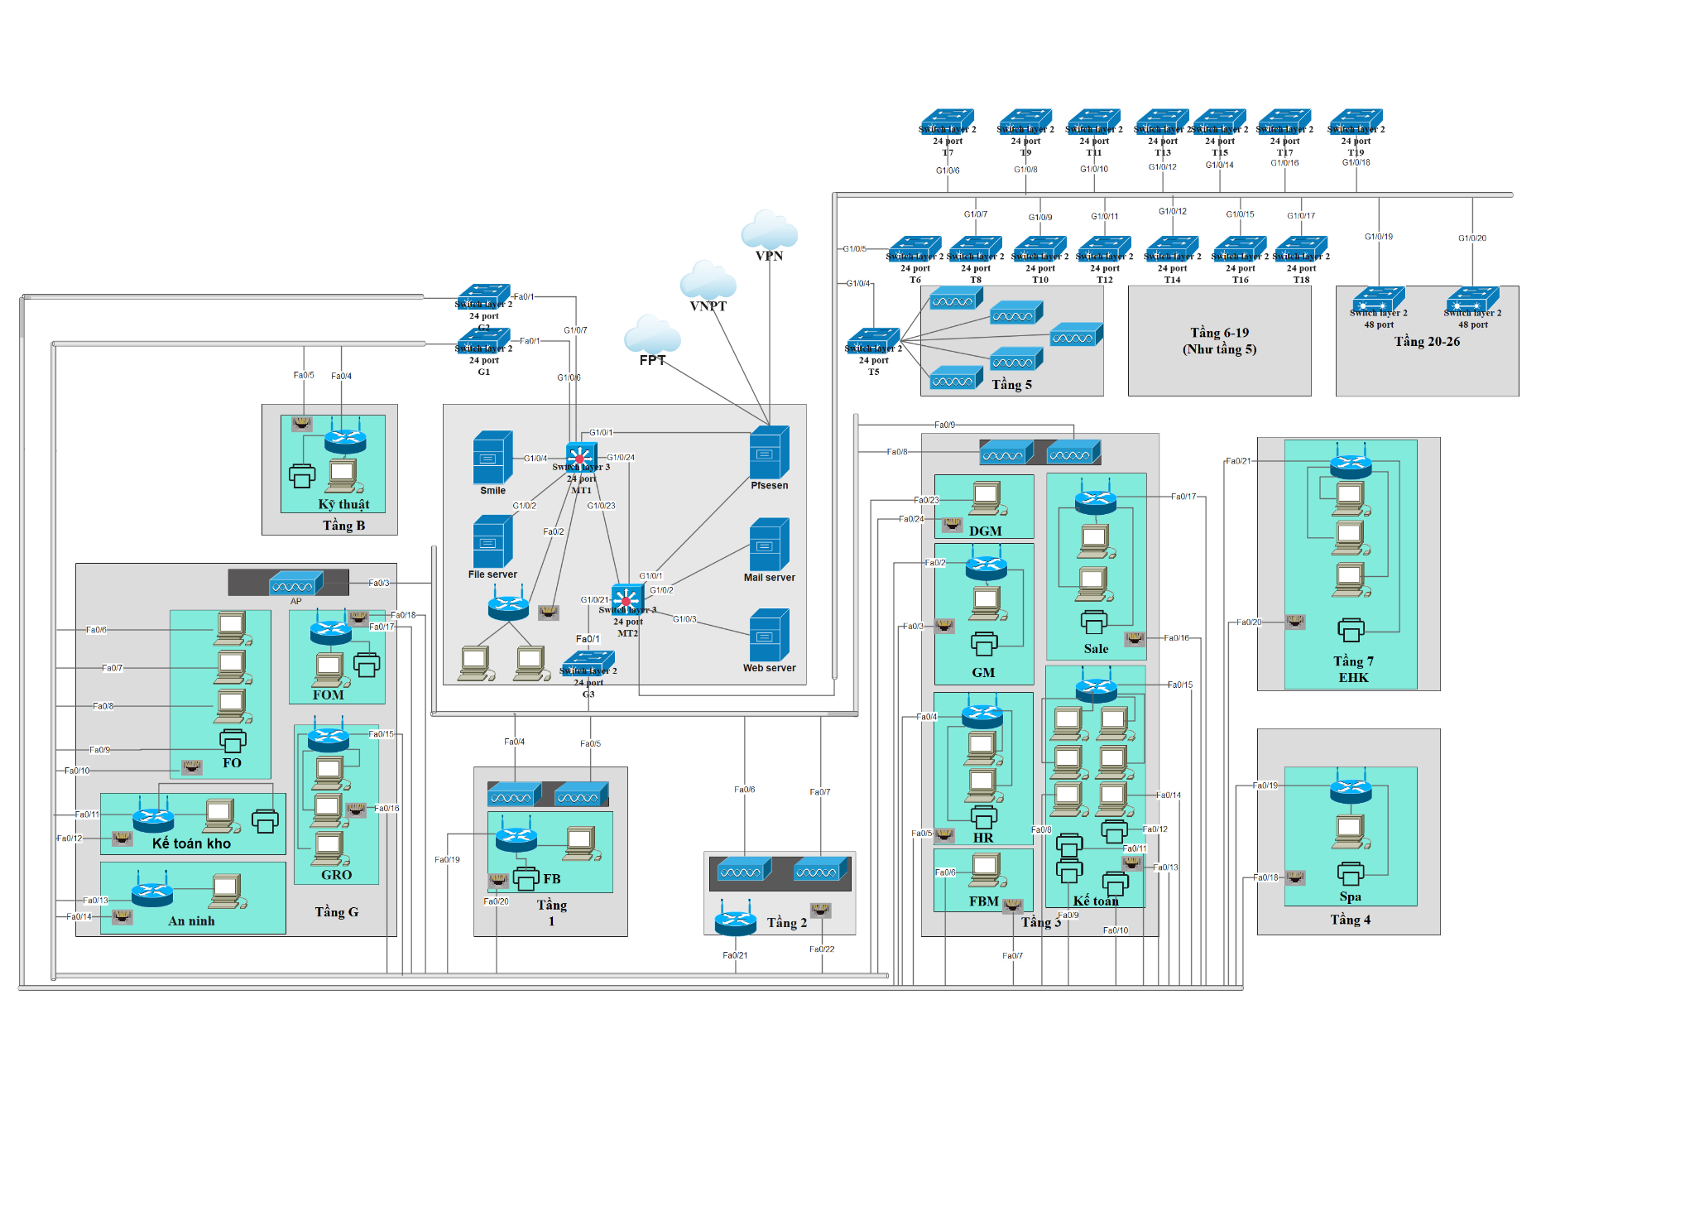
Network Design Steps
Phase 3 – Physical Network Design

Slide 20
Network Design Steps
Phase 4 – Testing, Optimizing, and Documenting the Network Design
Test the network design
Optimize the network design
Document the network design

Slide 21
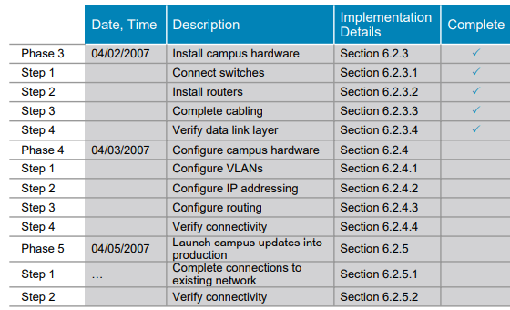
Network Design Steps
Phase 5 - Implement Phase

Slide 22
The PDIOO Network Life Cycle
Plan
Design
Retire
Optimize
Implement
Operate

Slide 23
Business Goals
Increase revenue
Reduce operating costs
Improve communications
Shorten product development cycle
Expand into worldwide markets
Build partnerships with other companies
Offer better customer support or new customer services

Slide 24
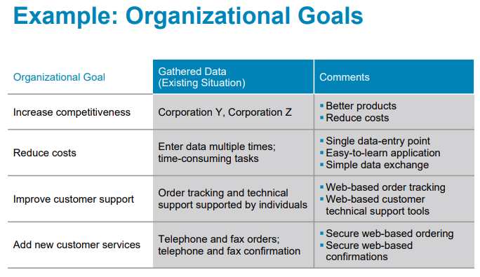
Business Goals

Slide 25
Recent Business Priorities
Mobility
Security
Resiliency (fault tolerance)
Business continuity after a disaster
Network projects must be prioritized based on fiscal goals
Networks must offer the low delay required for real-time applications such as VoIP
Notes:
Resiliency means how much stress a network can handle and how quickly the network can rebound from problems, including security breaches, natural and unnatural disasters, human error, and catastrophic software or hardware failures.
Some experts, including Howard Berkowitz, have a mild dislike of the word “resiliency” as it sounds too much like a stretched rubber band or a trampoline. As Berkowitz says in his excellent book, WAN Survival Guide (Wiley 2001), “I avoid designing networks that stretch too far, bounce up and down, or oscillate between normal and backup states.”
So he likes “fault tolerance,” but he points out that it does not mean “immune to any conceivable threat.” Berkowitz states that, “A sufficient quantity of explosives can overcome the tolerance of any network.” :-)

Slide 26
Business Constraints
Budget
Staffing
Schedule
Politics and policies

Slide 27
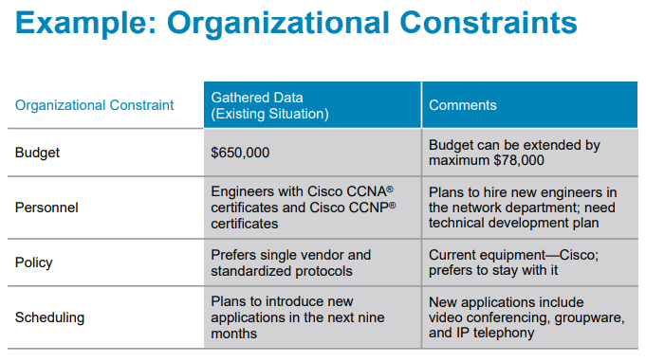
Business Constraints

Slide 28
Collect Information Before the First Meeting
Before meeting with the client, whether internal or external, collect some basic business-related information
Such as
Products produced/Services supplied
Financial viability
Customers, suppliers, competitors
Competitive advantage

Slide 29
Meet With the Customer
Try to get
A concise statement of the goals of the project
What problem are they trying to solve?
How will new technology help them be more successful in their business?
What must happen for the project to succeed?

Slide 30
Meet With the Customer
What will happen if the project is a failure?
Is this a critical business function?
Is this project visible to upper management?
Who’s on your side?

Slide 31
Meet With the Customer
Discover any biases
For example
Will they only use certain company’s products?
Do they avoid certain technologies?
Do the data people look down on the voice people or vice versa?
Talk to the technical and management staff

Slide 32
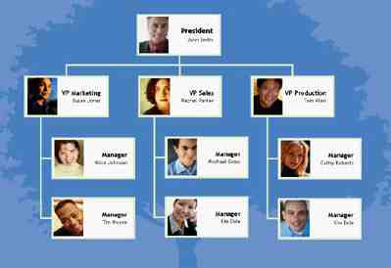
Meet With the Customer
Get a copy of the organization chart
This will show the general structure of the organization
It will suggest users to account for
It will suggest geographical locations to account for

Slide 33
Meet With the Customer
Get a copy of the security policy
How does the policy affect the new design?
How does the new design affect the policy?
Is the policy so strict that you (the network designer) won’t be able to do your job?
Start cataloging network assets that security should protect
Hardware, software, applications, and data
Less obvious, but still important, intellectual property, trade secrets, and a company's reputation

Slide 34
The Scope of the Design Project
Small in scope?
Allow sales people to access network via a VPN
Large in scope?
An entire redesign of an enterprise network
Use the OSI model to clarify the scope
New financial reporting application versus new routing protocol versus new data link (wireless, for example)
Does the scope fit the budget, capabilities of staff and consultants, schedule?

Slide 35
Gather More Detailed Information
Applications
Now and after the project is completed
Include both productivity applications and system management applications
User communities
Data stores
Protocols
Current logical and physical architecture
Current performance
Notes:
User communities, data stores, protocols, and the current architecture and performance will be discussed in the next few chapters. This chapter focuses on business needs and applications, which should be the first area of research in a top-down network design project. Network design is iterative, however, so many topics are addressed more than once as the designer gathers more detailed information and conducts more precise planning. So, gaining a general understanding of the size and location of user communities, for example, might be appropriate at this stage of the design project, but user communities should be investigated again when characterizing network traffic.

Slide 36
Network Applications
Name of Application
Type of Application
New Application?
Criticality
Comments

Slide 37
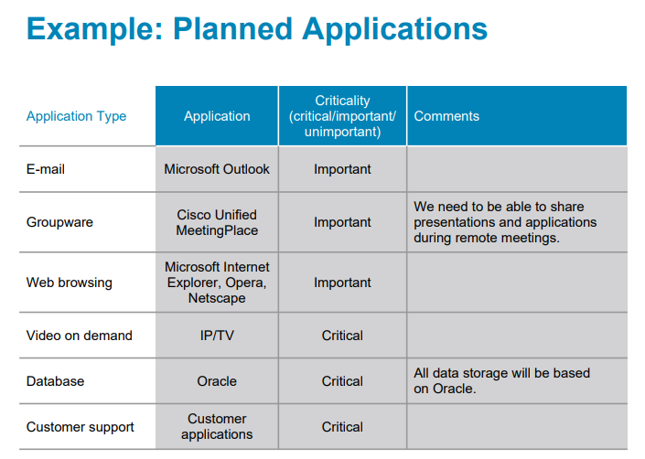
Network Applications

Slide 38
Summary
Systematic approach
Focus first on business requirements and constraints, and applications
Gain an understanding of the customer’s corporate structure
Gain an understanding of the customer’s business style

Slide 39
Review Questions
What are the main phases of network design per the top-down network design approach?
What are the main phases of network design per the PDIOO approach?
Why is it important to understand your customer’s business style?
What are some typical business goals for organizations today?

Slide 40
Q&A

